Slide 1

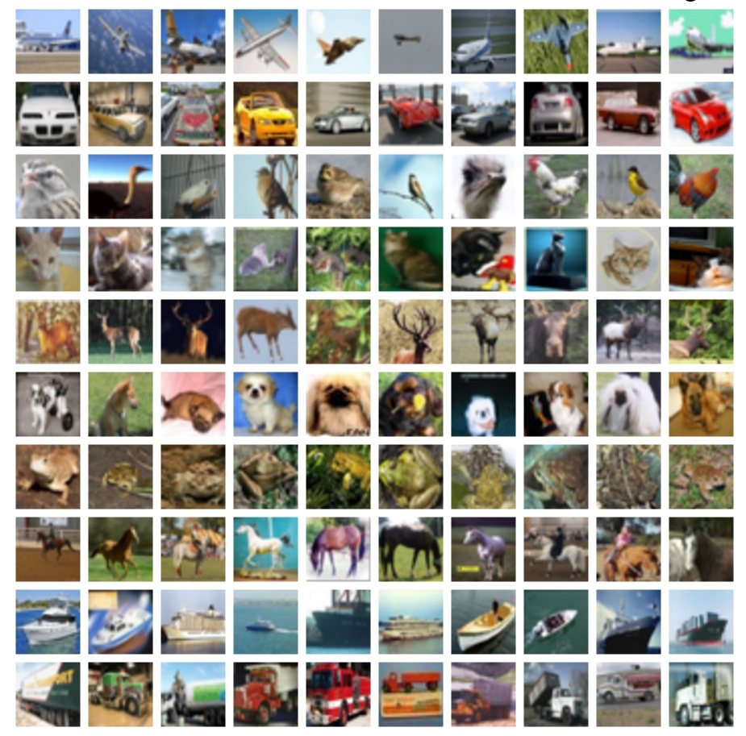
A Convolutional Exploration
Gus Ostow

Slide 2
Intentions
Learn a solid set of skills … not change the world
Avoid the time sink of data collection and preparation
Sink my teeth into neural networks
Learn the neural net training tricks
Prepare myself for more advanced arenas like robotics and self-driving cars

Slide 3
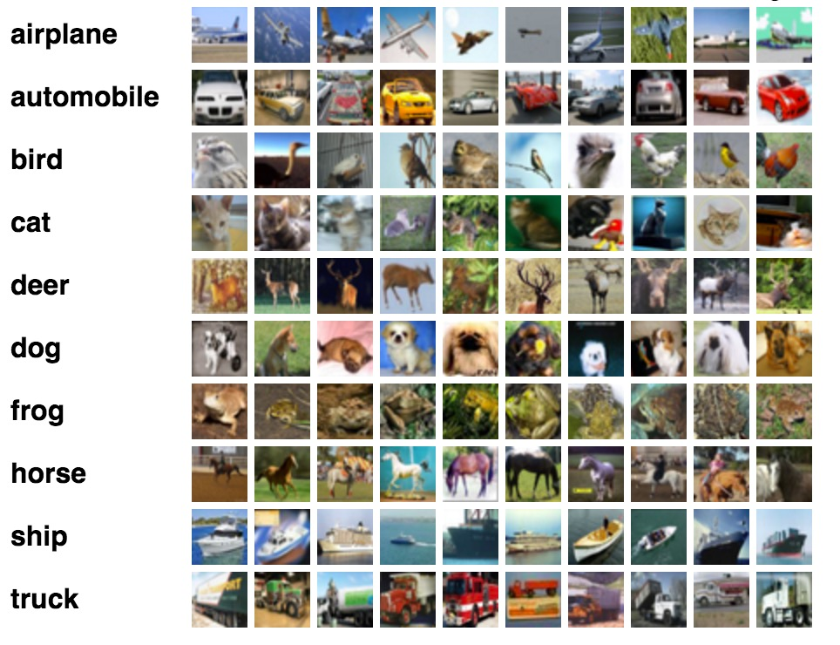
CIFAR -10 dataset (my playground)
60,000 tiny images
Ten classes
Popular image classification benchmark
State of the art: 96% accuracy

Slide 4
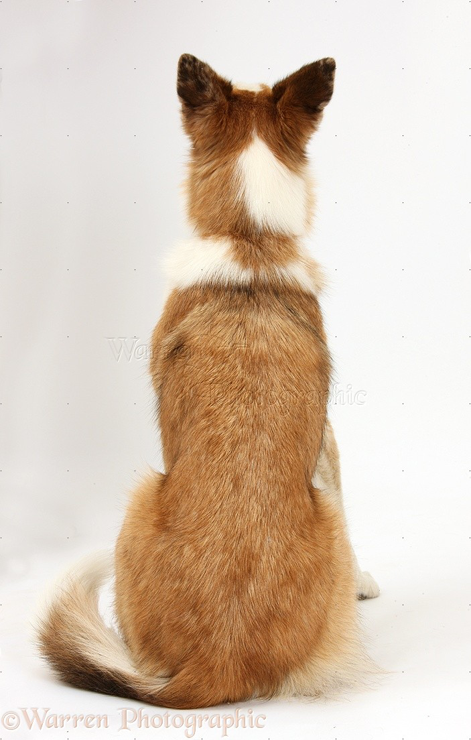
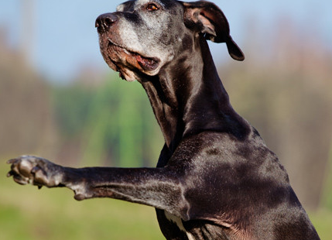
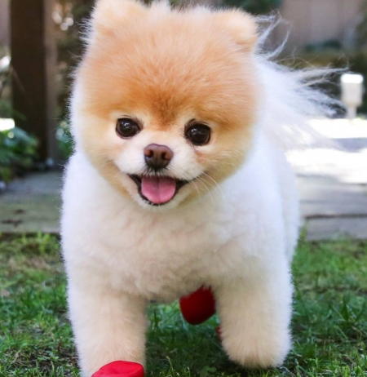

Object recognition is tough!
A dog is a dog regardless of:
Lighting
Orientation / location
Color
Cuteness
“Dog”

Slide 5
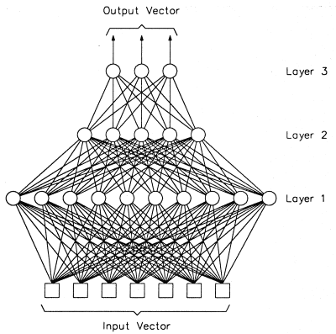

The naïve neural net approach
Fully-connected
layers
??
“unravel”

Slide 6
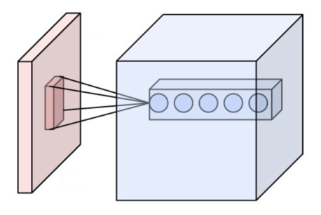
Solution: Convolutional neural networks (CNNs)
Offer 2D spatial structure to feed-forward neural networks
Exploit the fact that neighboring pixels are usually related to the same higher level feature
Features may appear anywhere in an image
Transform raw images into a more linearly separable space
(generally) Composed of three types of layers:
Convolutional
Pooling
Fully-connected Layer

Slide 7
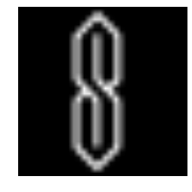
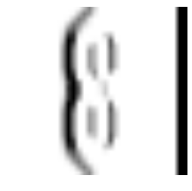

The convolutional layer
Find regions of the input image that match a specific set of filters
Filters are small square patterns that are slid across the image to assess similarity
Vertical
filter
Vertical feature map

Slide 8
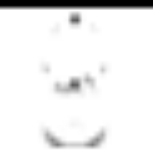
The convolutional layer
Find regions of the input image that match a specific set of filters
Filters are small square patterns that are slid across the image to assess similarity
Horizontal
feature map
Horizontal
filter

Slide 9
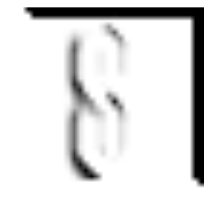
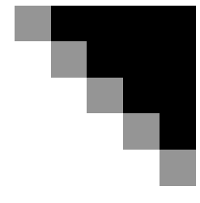
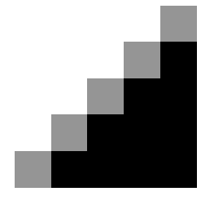
The convolutional layer
Find regions of the input image that match a specific set of filters
Filters are small square patterns that are slid across the image to assess similarity
Diagonal
feature map
Diagonal filter

Slide 10

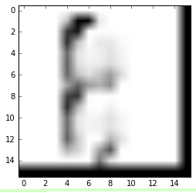
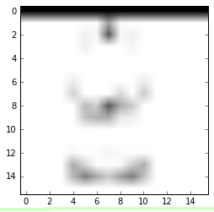
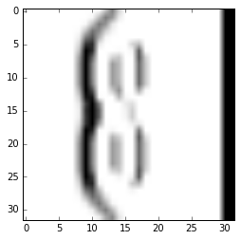
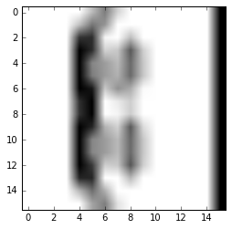
Pooling layers
Outputs the most activated pixel in local rectangular regions of the feature map
Down-samples the spatial size of the representation which:
Reduces the complexity of the network
Offers some level of translation invariance
Pooled feature maps
Vertical feature map
max

Slide 11

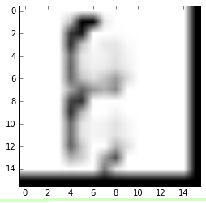
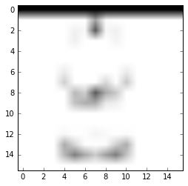
Final classification
Time to classify the transformed image!
Fully connected
layer
Feature volume
“unravel”
“S thing”

Slide 12
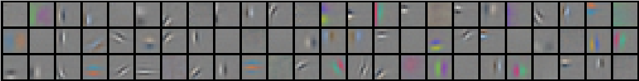
Where do the filters come from?
Traditional computer vision: painstakingly handcraft filters that sort
of work
Deep learning: learn them automatically!
Train: Find filters that minimize error on a training set
Predict: Generalize to fresh data

Slide 13
Backpropagation
Loss function: how far the model’s predictions from the true classes in the training set
Loss function depends on the predictions, which depend on the filters
How can we change the filters to minimize the loss function?
Take the gradient using backpropagation
the direction of steepest ascent on the loss function with respect to the filter weights

Slide 14
Optimization
The method for using the gradient to minimize the loss function during training
Dramatically affects convergence (IMPORTANT TO UNDERSTAND)
Gradient Descent: “Baby steps in the direction of steepest descent”
Most basic optimizer
GD + Momentum: “Ball rolling down the loss mountain”
Much faster training,
Less susceptible to local minima
Adam: “Ball rolling that’s extra sensitive to historically inactive parameters”

Slide 15

Optimization
Optimizers with momentum accelerate down slope
Adaptive optimizers pick up on subtle changes in gradient

Slide 16
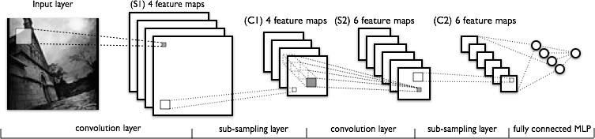
The big picture
String together any number of convolution and subsampling layers
Some CNNs have hundreds or even thousands of layers
All have the same basic ingredients
Finish with fully-connected layers to make the classification on feature space

Slide 17
My process
Keras on top of TensorFlow
Nets take too much time to train to use gridsearch
Carefully train a ton of networks
Save everything
Try to stay organized and smart about it
Learn

Slide 18
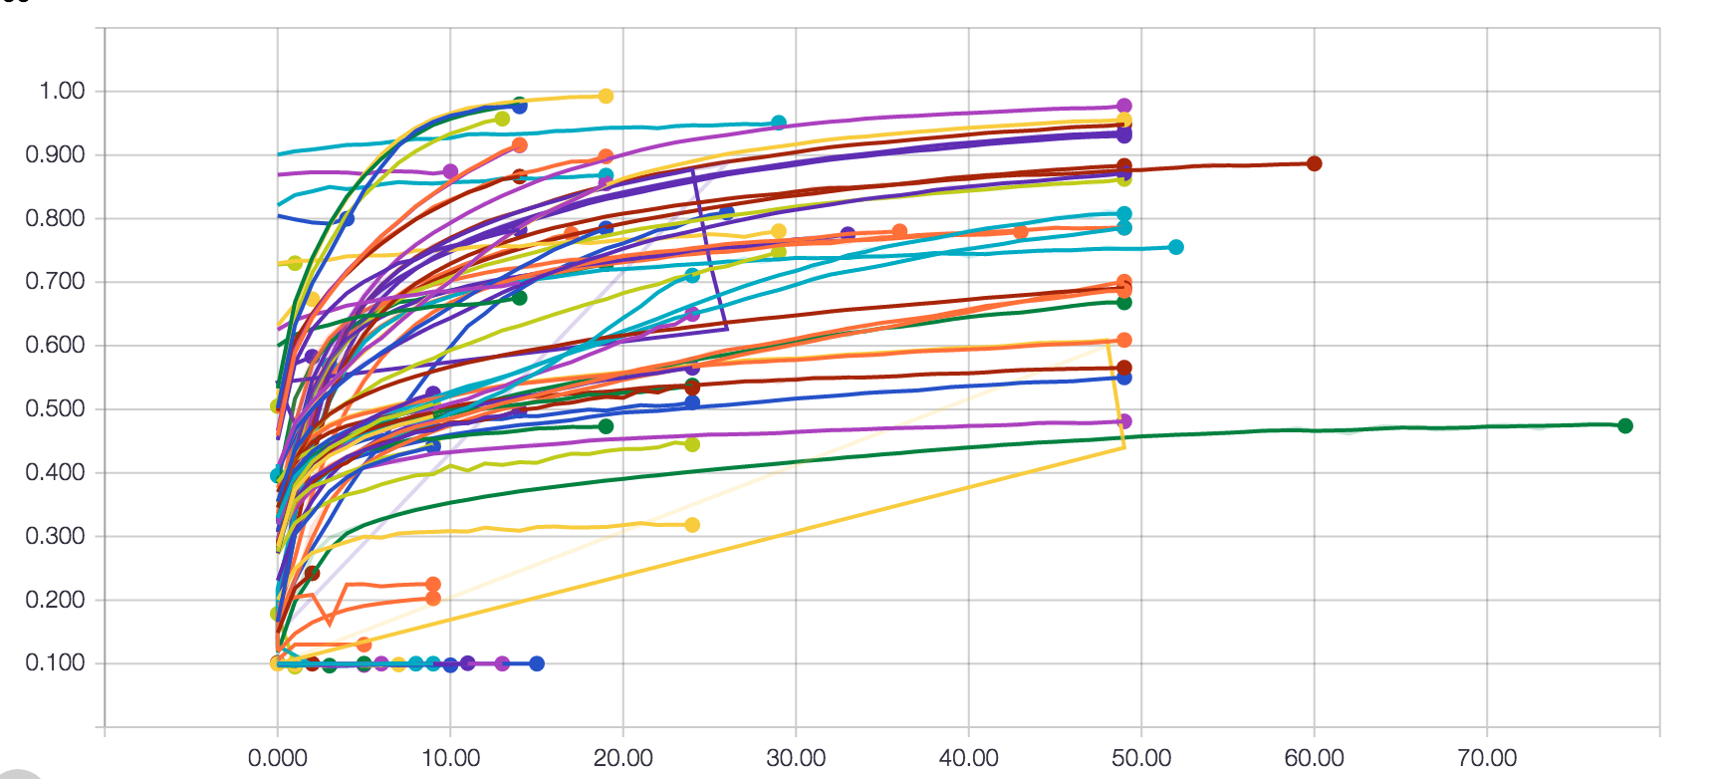
My process
A fraction of my total runs

Slide 19
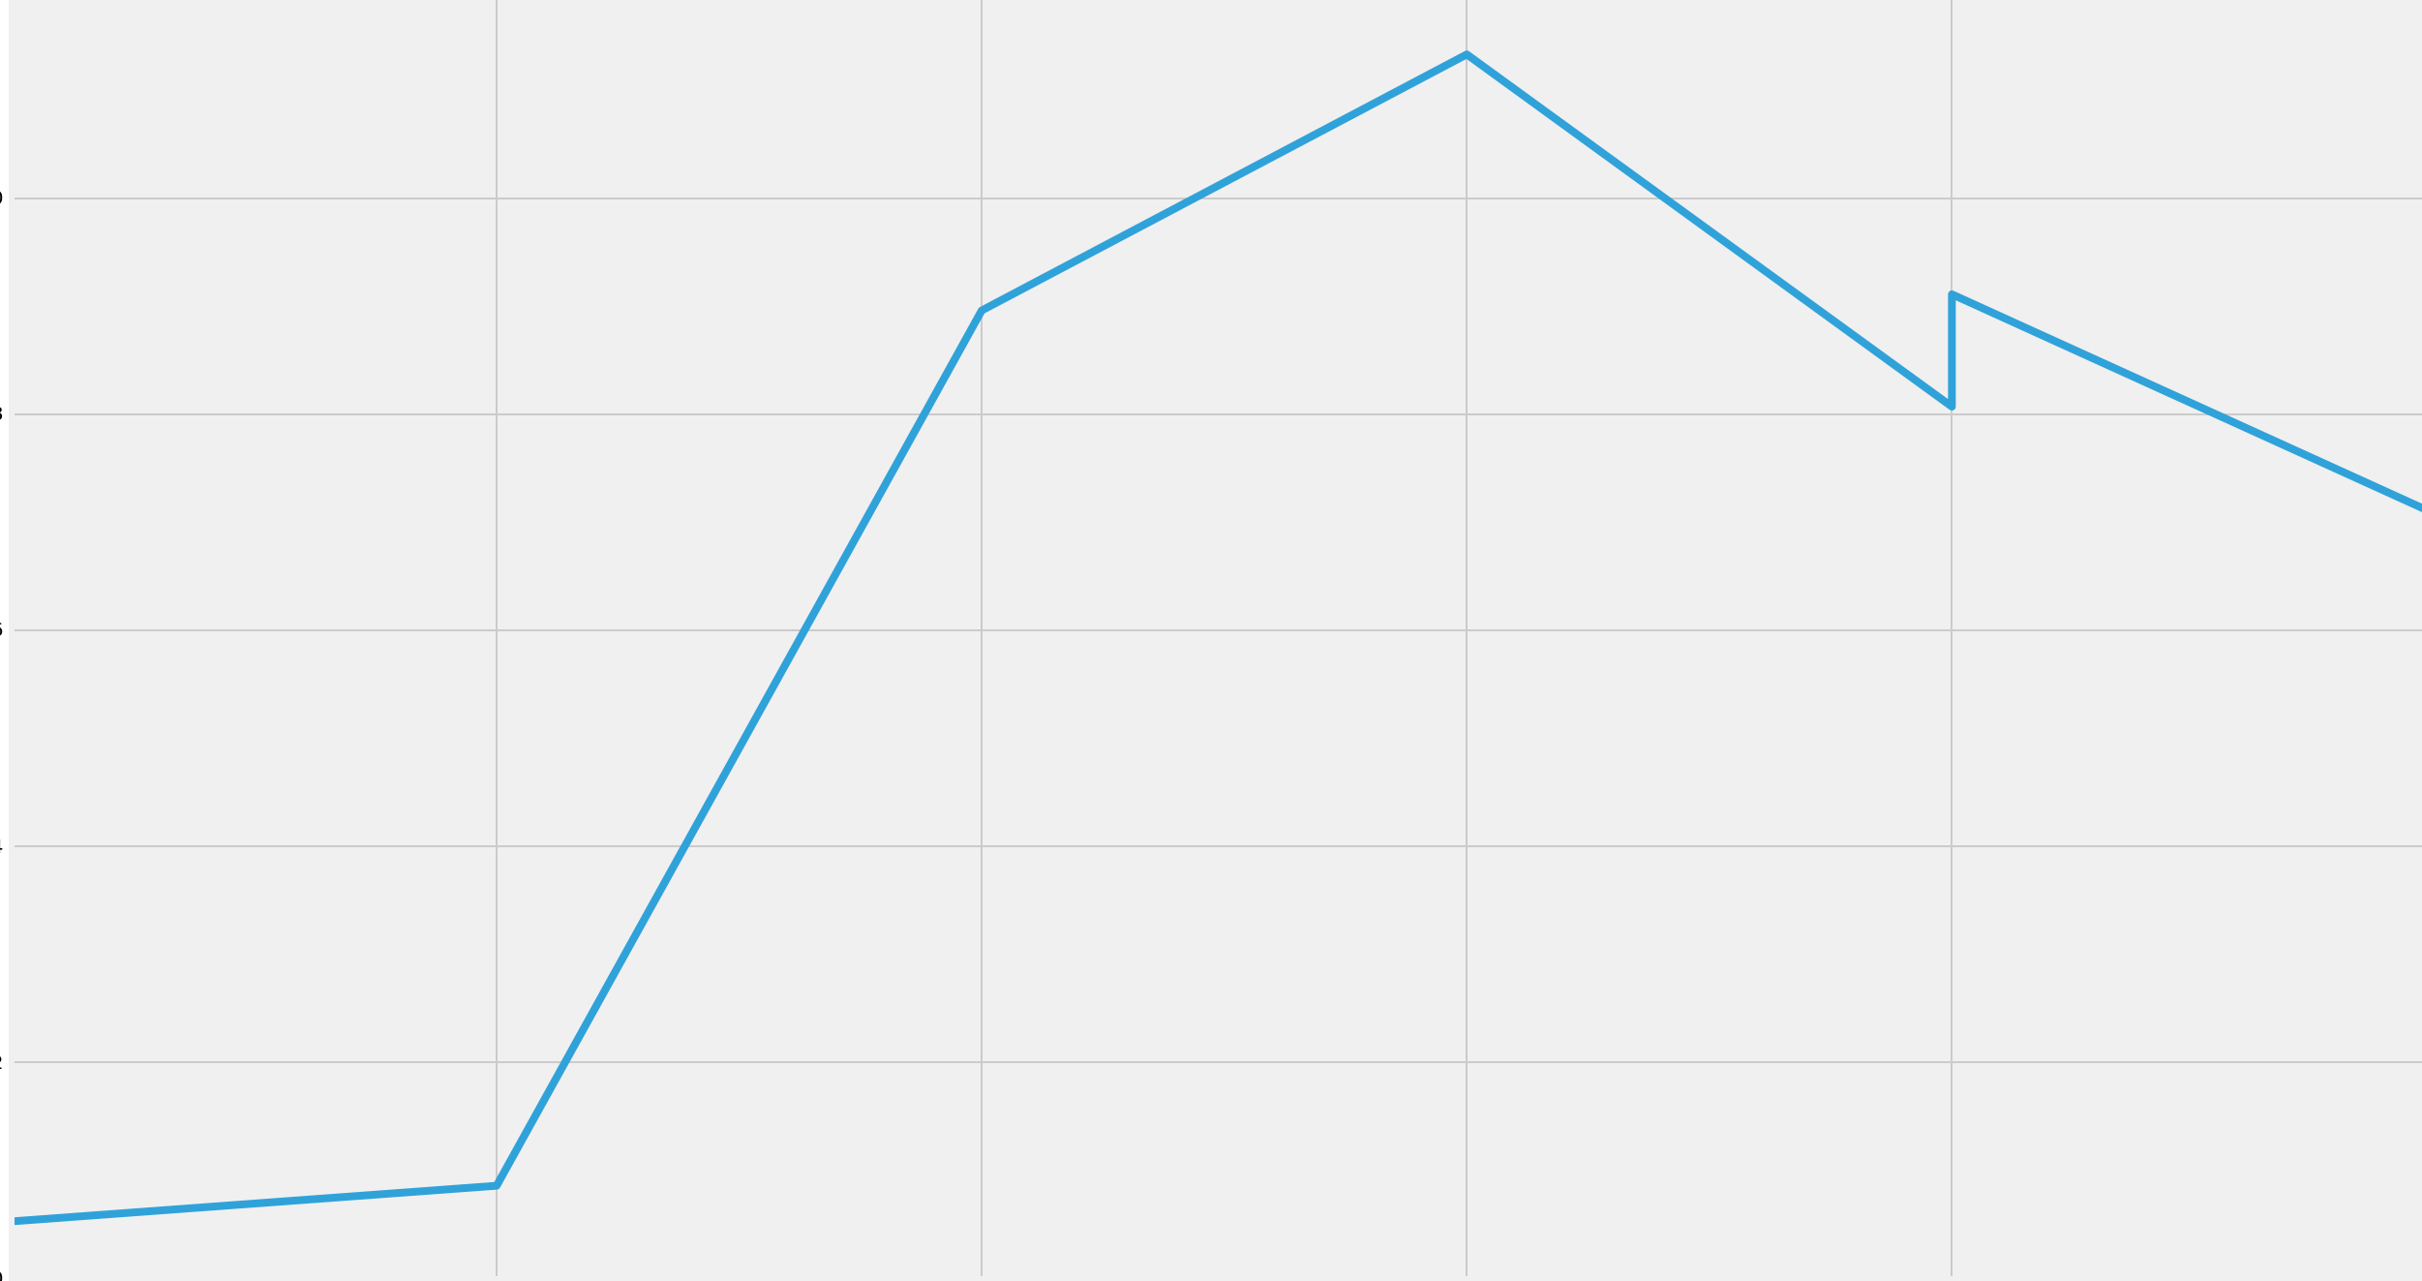
Baseline results
How well do standard multi-layer perceptrons fare at CIFAR?
What affects performance?
Width, depth, optimizer, batch normalization, activation function, etc
55%
Best standard NNs top out
at ~55% accuracy
Depth only improves
accuracy for up to three layers
Hurts after … probably
due to overfitting
# validation accuracy
0
# of hidden layers
5

Slide 20
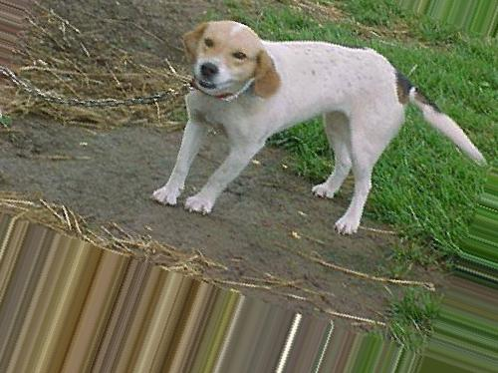
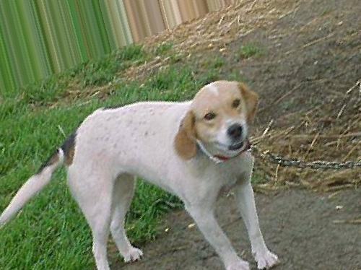
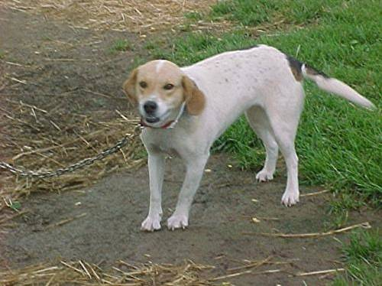
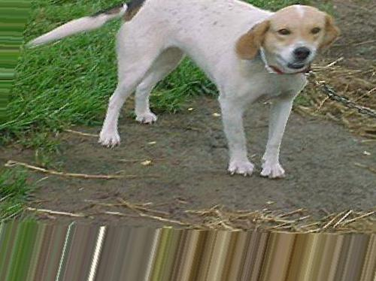
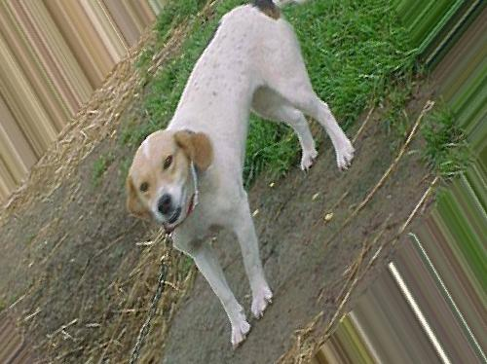
Combatting over-fitting
Dropout
Conventional regularization (ridge, lasso, elastic)
Data Augmentation
Original Image

Slide 21
Data-augmentation
“Generate the invariance you want to see in the network”

Slide 22
Batch-normalization
The input to deep layers depends on the behavior of all previous layers
Small changes in early layers have BIG effects on later ones
Slows down training
Normalize layer input based on the statistics from mini –batches
Speeds up training!

Slide 23
The bug: why my progress is somewhat unimpressive
A bug so subtle and insidious I sometimes doubted my own sanity
Training stuck at 10% inexplicably … even on Keras example code (WTF)
But only sometimes and for certain configurations
Held me up since thanksgiving
Seems to be something to do with stochastic gradient descent’s momentum

Slide 24
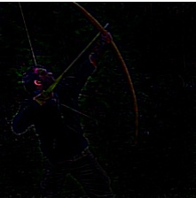
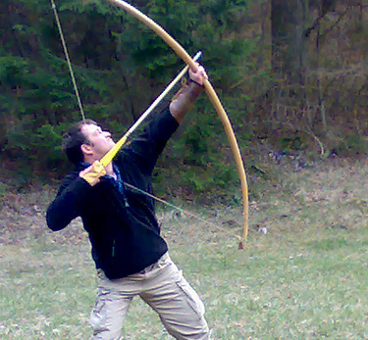
What does a network actually learn?
CNNs aren’t as much of a blackbox as conventional neural networks
Guided backpropagation: which pixels are affecting the prediction?
Visualize derivative of the max prediction with respect to input image
“Bow”

Slide 25
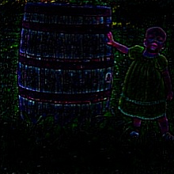
What does a network actually learn?
“Barrel”

Slide 26
Next Steps
Obliterate the insidious bug
Start writing pure TensorFlow code
Hit true state of the art accuracies
Finish my self-driving RC car

